Slide 1
Adaptive Planning for Piney Run, MD
Stability and resiliency in a changing climate
By Kimberly Allen, Michala L. Hendrick, Jack J. Saladino, Morgan E. Thomas, Keigan A. Thornton & Tiffany N. Wood

Slide 2
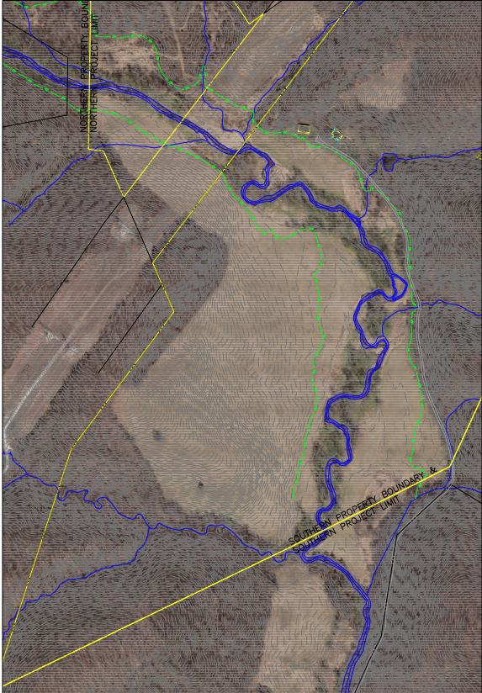
Introduction
Keigan A. Thornton
The Location
Piney Run is located in Baltimore County, Maryland.
Considered a a Class III-P stream by the Maryland Department of the Environment (MDE).

Slide 3
Introduction
Keigan A. Thornton
A Transdisciplinary Approach
The Challenges
Piney Run is a small stream with large impacts. However it is also tied into a small rural community.
Landowner perceptions of outside agents
Working with other groups that have influenced Piney Run
Lack of interaction due to COVID precautions
Interconnected disciplinary space
Sustainability Sciences and other ‘hard’ sciences
Social Sciences and community interactions

Slide 4
Introduction
Keigan A. Thornton
The Audience
The MARI Case Study Format
Currently Piney Run is involved in a stream restoration project in order to ensure the long term health of the water way.
The novel instance of this project opens a door for a variety of groups to use Piney Run as a flagship.
The Mitigation and Adaptation Research Institute (MARI) discusses and involves :
wicked problems
sustainability futures
mitigation of threats
adaptation to changes
clear communication
diverse audiences
Notes:
The Audience includes those working on Piney Run but then the following groups as well that could use this situation as a model for local restoration and sustainability practices.
The landowners involved, Stream restoration project currently involved, Future landowners, Restoration groups/companies, Educational Institutions, Government organizations, Non-government organizations.

Slide 5
Introduction
Keigan A. Thornton
Our Goals Include:
Informing the audience of the decision space, who is involved and who should be included.
Addressing the wicked problem that the system faces.
Discussing and understanding the system as it interacts within and outside of itself.
Producing futures, outcomes and possible solutions for the system.
Give recommendations for the stakeholders to ensure the the longevity of the system.

Slide 6
Societal Context and Decision Making
Kimberly Allen
Experts, stakeholders, government, local community organizations, and organizations of interest are identified.
Stakeholders and authorities will be mapped on levels of authority and interest.
Rules must be established to simulate economic, laws and regulations, social norms, and ethical decision making.
A conceptual model is made to identify key variables of the system and their interactions.

Slide 7
Mapping the decision making space
Kimberly Allen
High resources/ authority
Carroll county dep. Of land and resource mgmt.
Carroll county gvmt. Officials
Private landowners
Water treatment plant managers
MD Freshwater fish division
Baltimore county Natural Resource department
Balt. County department of planning
Baltimore county soil conservation district
Low interest
High interest
NGOs
Local ag. Owners
Potential fish stocking stakeholders
Local businesses (brewery, horse farm?)
Low resources/ authority

Slide 8
Mapping the decision making space
Kimberly Allen
High resources/ authority
Carroll county dep. Of land and resource mgmt.
Carroll county gvmt. Officials
Private landowners
Water treatment plant managers
MD Freshwater fish division
Baltimore county Natural Resource department
Balt. County department of planning
Baltimore county soil conservation district
High interest

Slide 9
Mapping the decision making space
Kimberly Allen
High interest
NGOs
Local ag. Owners
Low resources/ authority

Slide 10
Societal Context and Decision Making
Kimberly Allen
High leverage
3A
Economic Rules
Profit oriented thinking (as an inhibitor)
Non-ag. BMP fees
Privately funded, grant, partnerships
Industrial Use responsibilities and regulations
1C
2A
2B
2E
4C
1D
2C
4B
Laws and Regulations
Local land codes and water regulation
Private property rights
Species specific laws/regulations for flora and fauna
Agricultural Regulations
Industry rights
3B
3C
2D
1A
Low relevance
High relevance
Ethics
The landowner's intent is to restore the integrity of Piney Run through partnership and and collaboration with landowners
The project is driven by personal ethics
Watershed sustainability
Ensuring Environmental Stewardship (researcher ethic)
4D
3D
Social Norms
Landowners have the option to do nothing (apathy)
Trust and communication between landowners are necessary to build a relationship and shared responsibility
Economy of the environment vs monetary economy
Improper agricultural practices
1B
4A
Low leverage

Slide 11
Participatory Modeling
Kimberly Allen
Create
Inform
Test
Create a decision space where authorities and stakeholders share knowledge, goals, and expectations.
Mapping engages Implicit and explicit knowledge of stakeholders and authorities to create a formalized and shared representation of reality.
Stakeholders and authorities are able to test, adjust, and learn about the system.

Slide 12
Societal Problem and Decision Making
Kimberly Allen
Goal Statement
“To make the restoration easement at Kings Eye a model of success for ecological restoration and fostering stewardship; thus, incentivizing future collaboration with other entities and landowners and ensuring ecological resilience and stability in a changing climate.”

Slide 13
Wicked Problem and Conceptual Model
Morgan Thomas
Wicked Problems are something that are not caused by one issue but multiple issues all affecting one problem
This multitude of problems all pooling together into one issue is what makes a problem wicked
Wicked problems are also very difficult to “solve” as they have so many negative factors affecting them

Slide 14
Wicked Problem and Conceptual Model
Morgan Thomas
The Piney Run bionetwork must be restored to an ecological standpoint that promotes a healthy ecosystem under the pressures of climate change.
The conceptual model seen shows the entire Piney Run system and shows how fragile the run really is. There are many smaller hazards within the run that combined and with the added pressure of climate change show the wicked problem that Piney Run is faced with.
Notes:
In order to fully understand the system, conceptual model

Slide 15
Wicked Problem and Conceptual Model
Morgan Thomas
Conceptual Models help to give a visual representation of the system as a whole
There are 4 systems within the run that have their own conceptual models
These 4 systems are Freshwater Ecology, Hydrology, Flora and Fauna, as well as Human System and Community

Slide 16
Wicked Problem and Conceptual Model
Morgan Thomas
Step 1
Step 2
Step 3
When creating the conceptual models the research team went through and assessed the aspects of the run imperative to include within the models.
The research team then created 4 models for Freshwater Ecology, Hydrology, Flora and Fauna, as well as Human System and Community.
After these 4 models were finalized the research team used these concepts to create our final cohesive conceptual models.

Slide 17
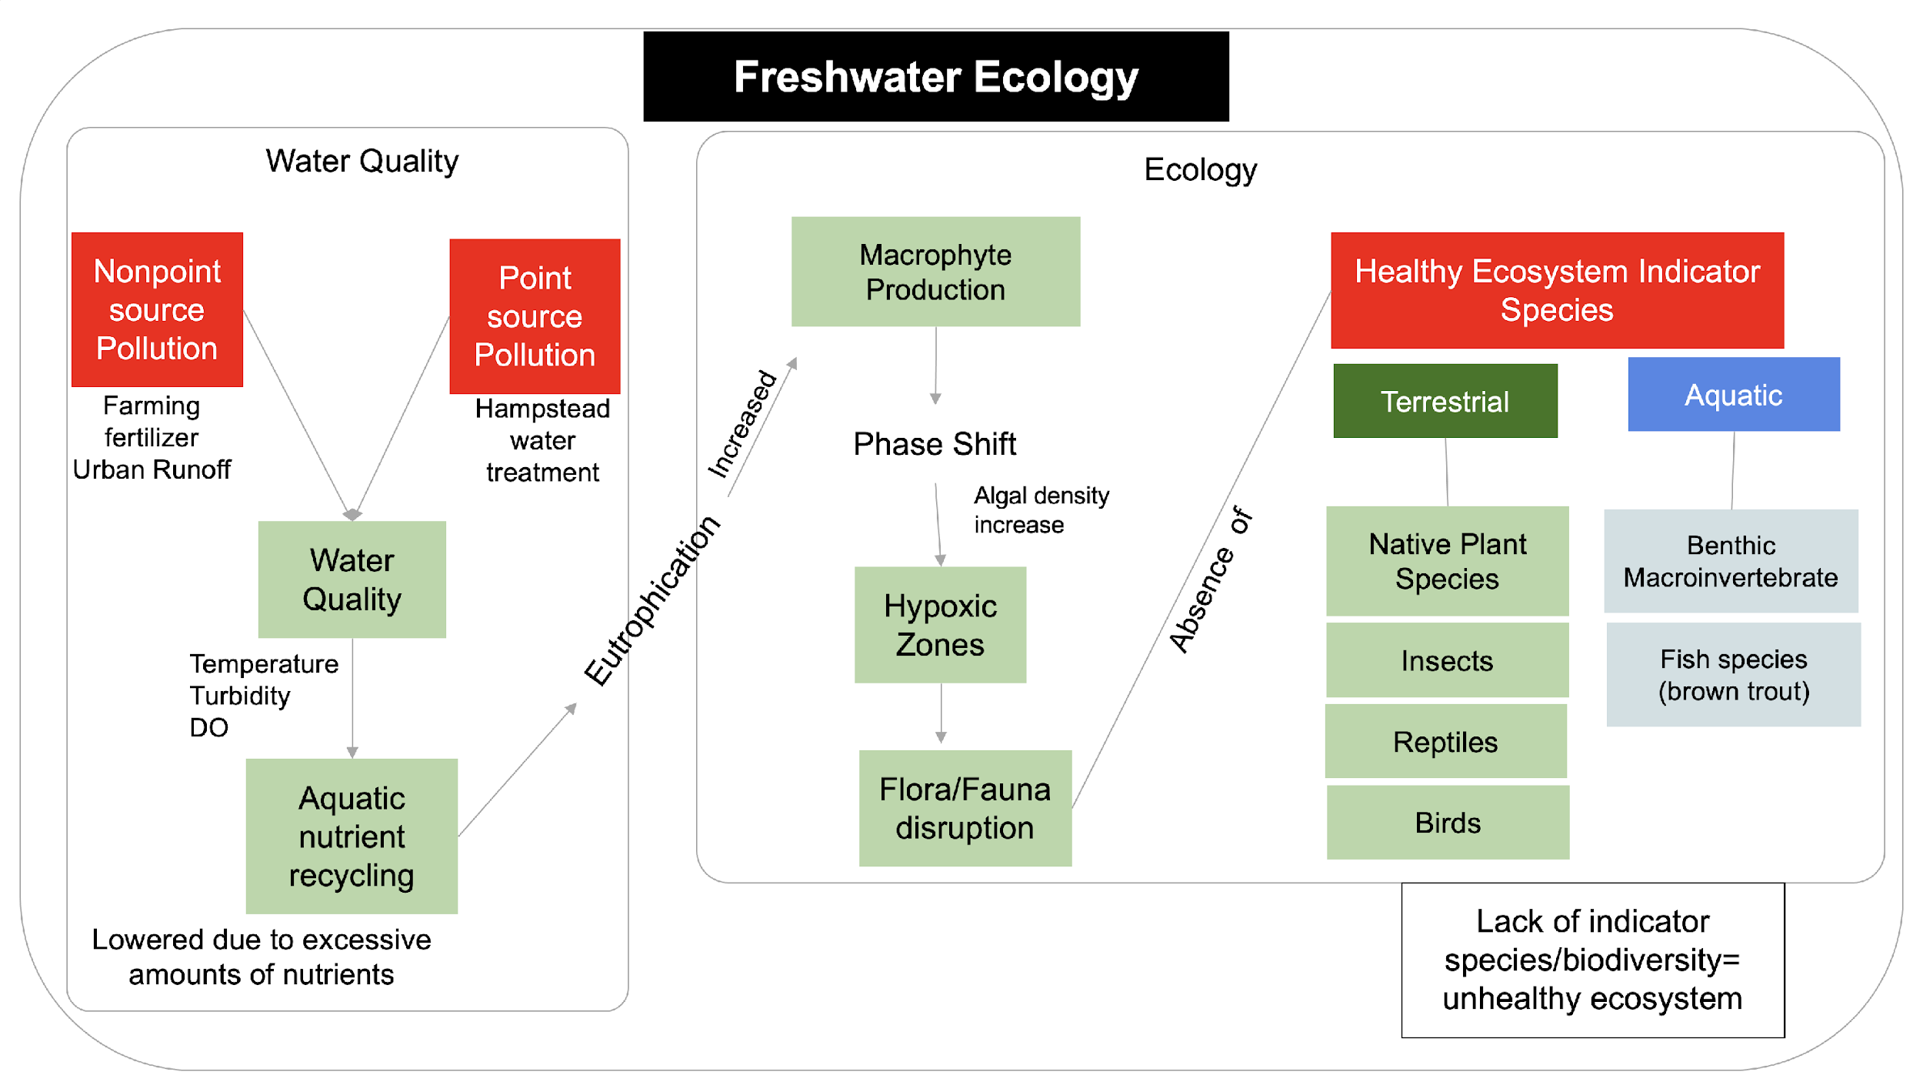

Slide 19
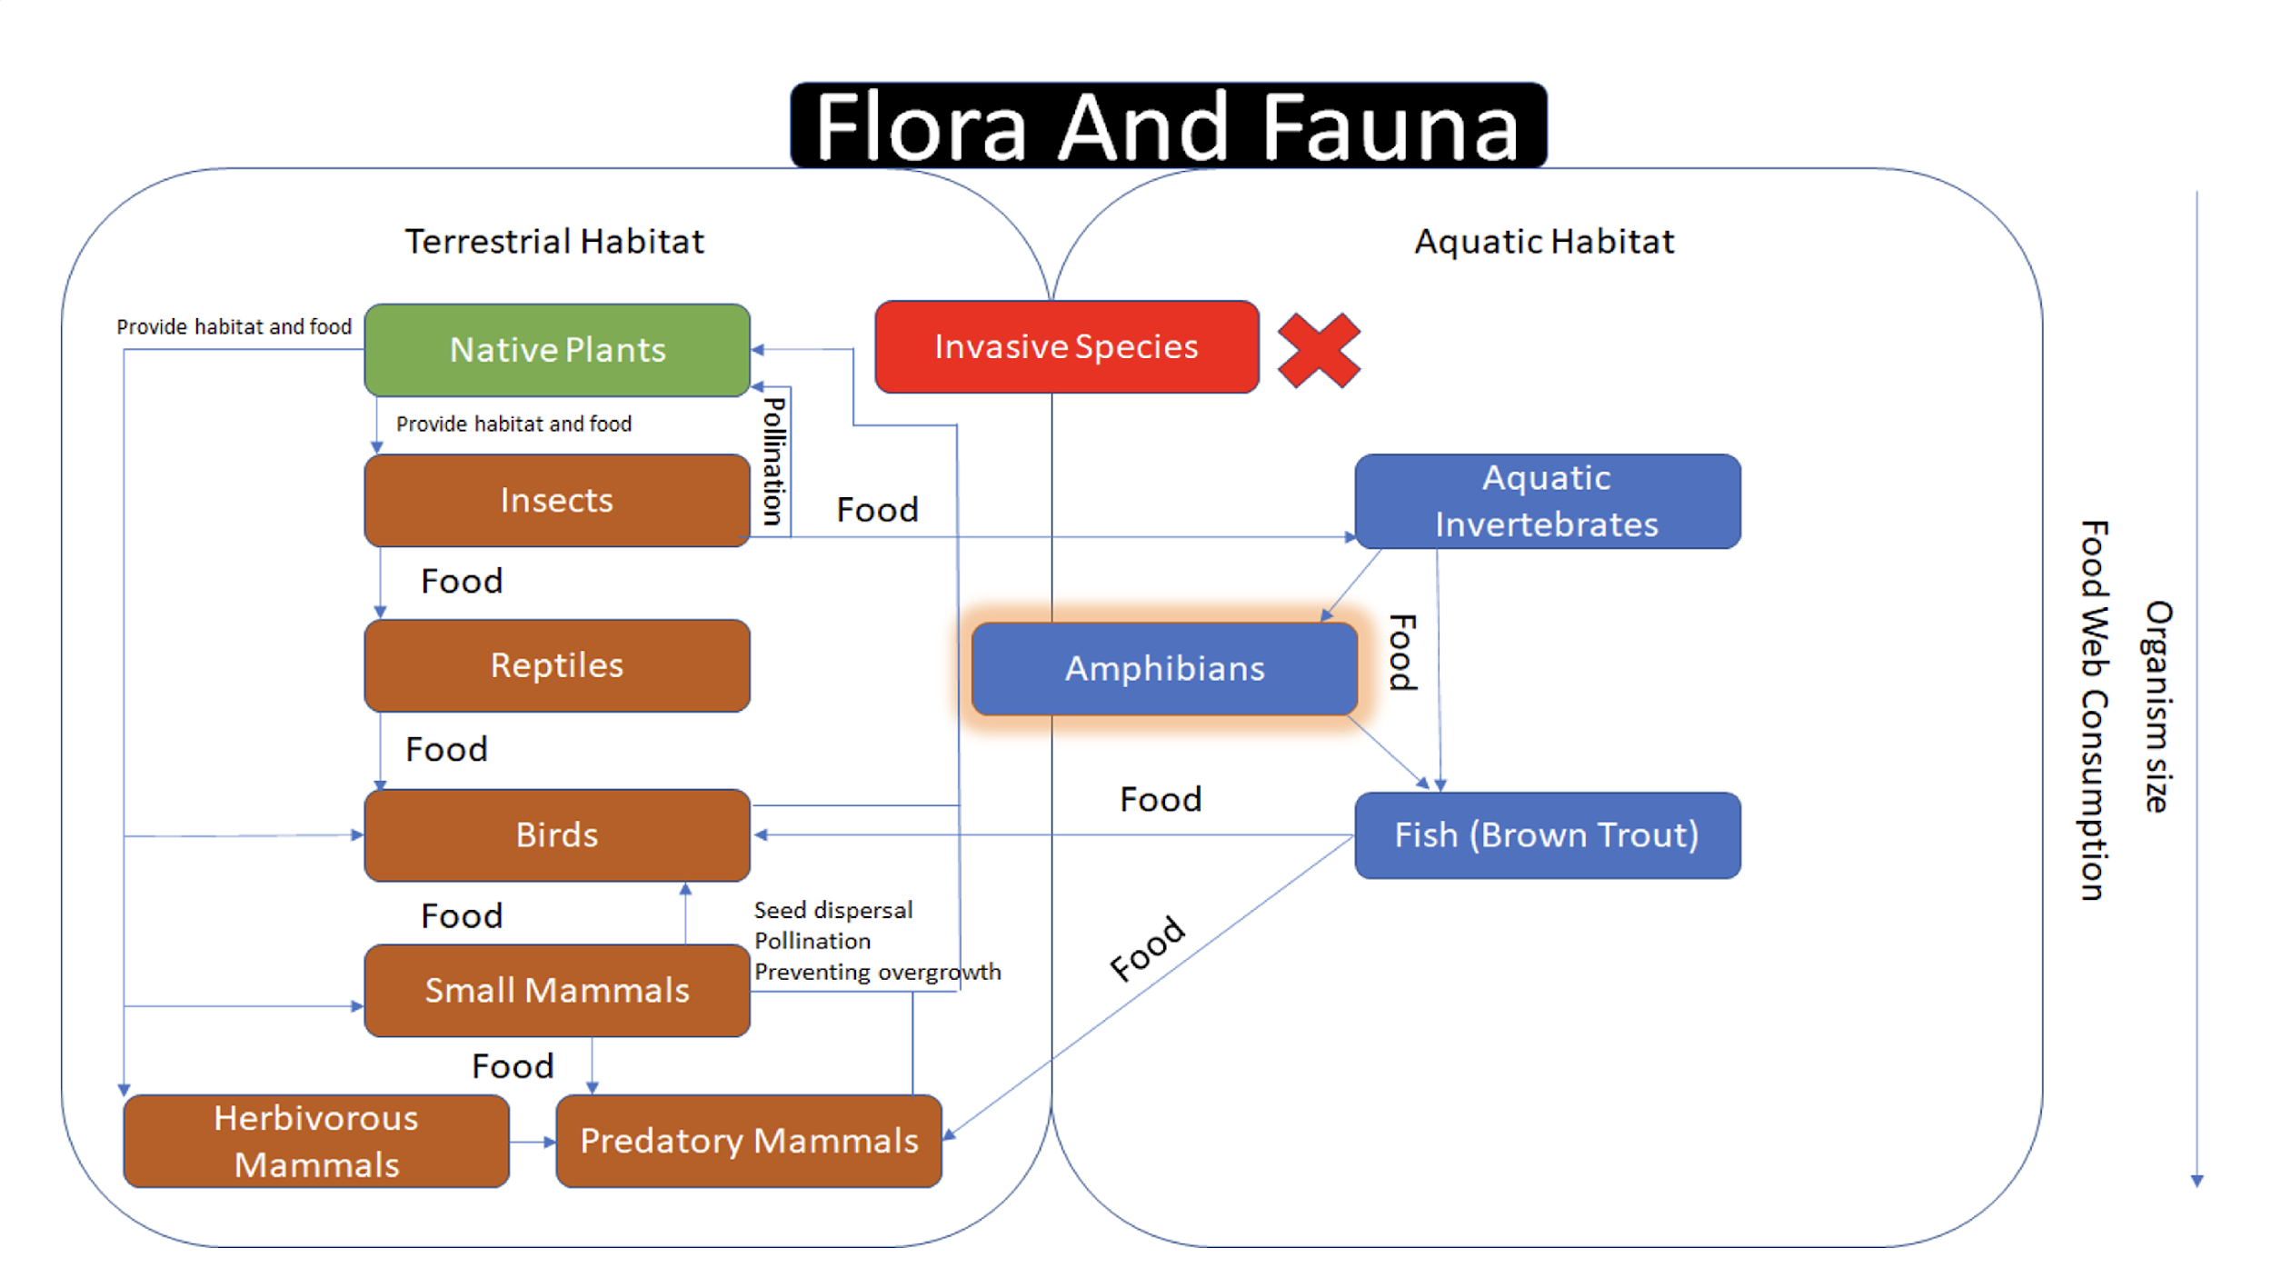

Slide 20
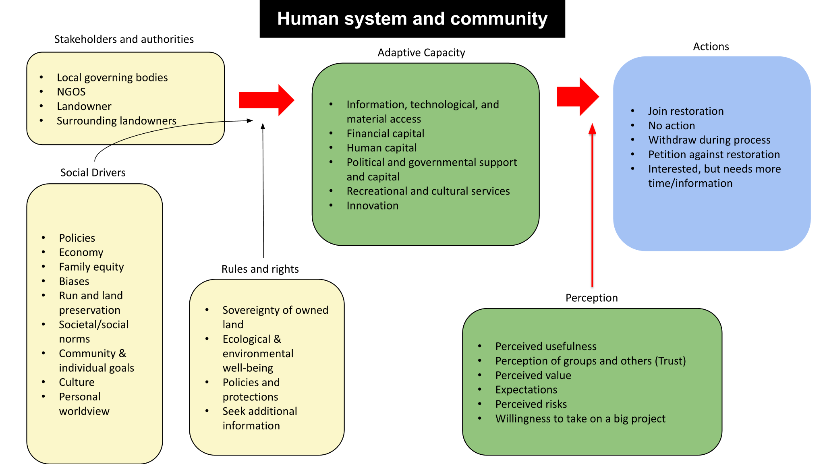

Slide 21
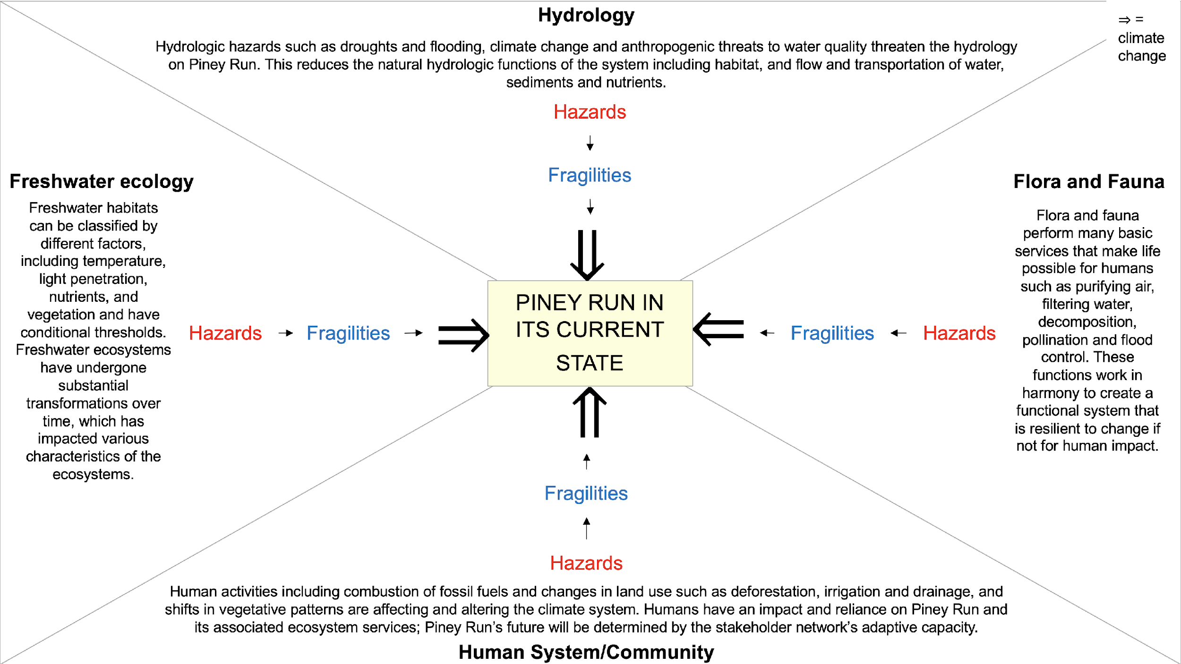
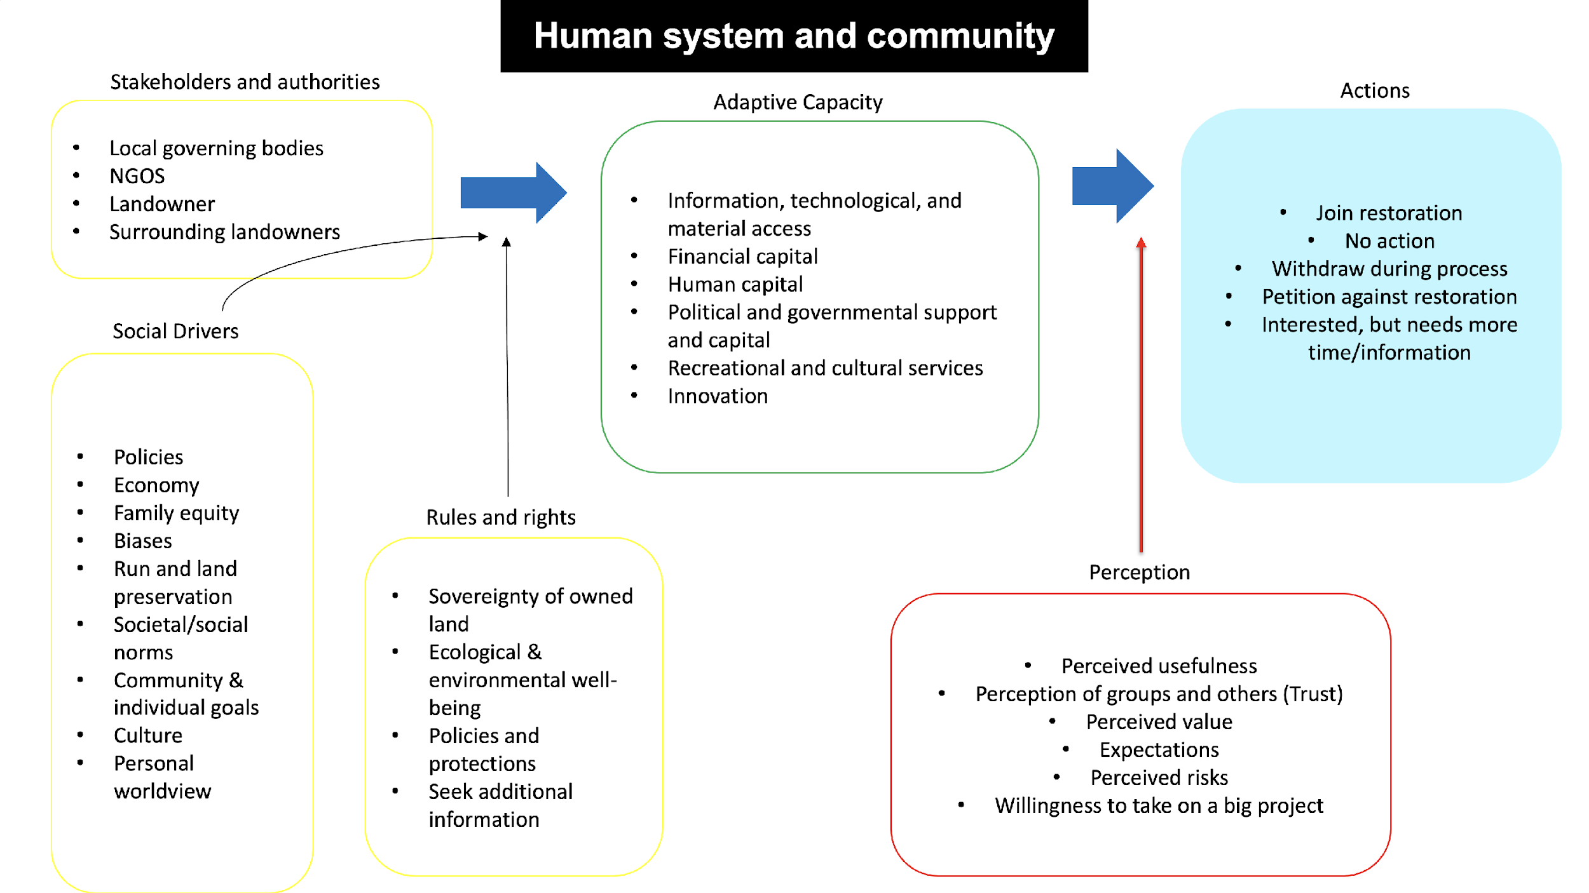

Slide 22
Hydrology
⇒ = climate change
Hydrologic hazards such as droughts and flooding, climate change and anthropogenic threats to water quality threaten the hydrology on Piney Run. This reduces the natural hydrologic functions of the system including habitat, and flow and transportation of water, sediments and nutrients.
Hazards
Freshwater ecology
Fragilities
Flora and Fauna
Freshwater habitats can be classified by different factors, including temperature, light penetration, nutrients, and vegetation and have conditional thresholds. Freshwater ecosystems have undergone substantial transformations over time, which has impacted various characteristics of the ecosystems.
⇒
Flora and fauna perform many basic services that make life possible for humans such as purifying air, filtering water, decomposition, pollination and flood control. These functions work in harmony to create a functional system that is resilient to change if not for human impact.
⇒
PINEY RUN IN ITS CURRENT STATE
⇒
Hazards
Fragilities
Fragilities
Hazards
⇒
Fragilities
Hazards
Human activities including combustion of fossil fuels and changes in land use such as deforestation, irrigation and drainage, and shifts in vegetative patterns are affecting and altering the climate system. Humans have an impact and reliance on Piney Run and its associated ecosystem services; Piney Run’s future will be determined by the stakeholder network’s adaptive capacity.
Human System/Community

Slide 23
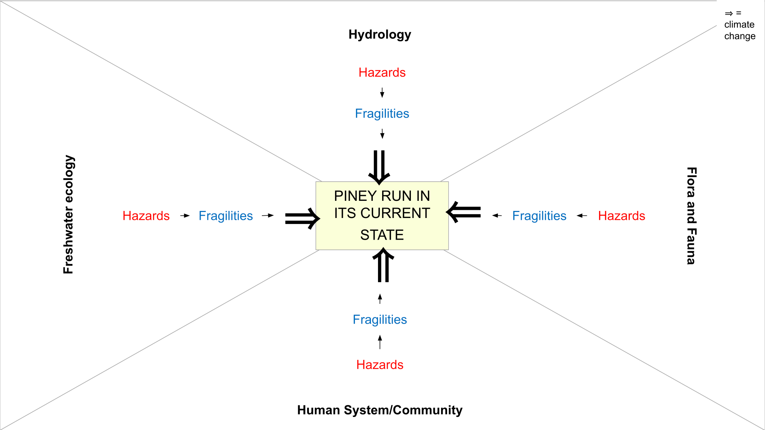

Slide 24
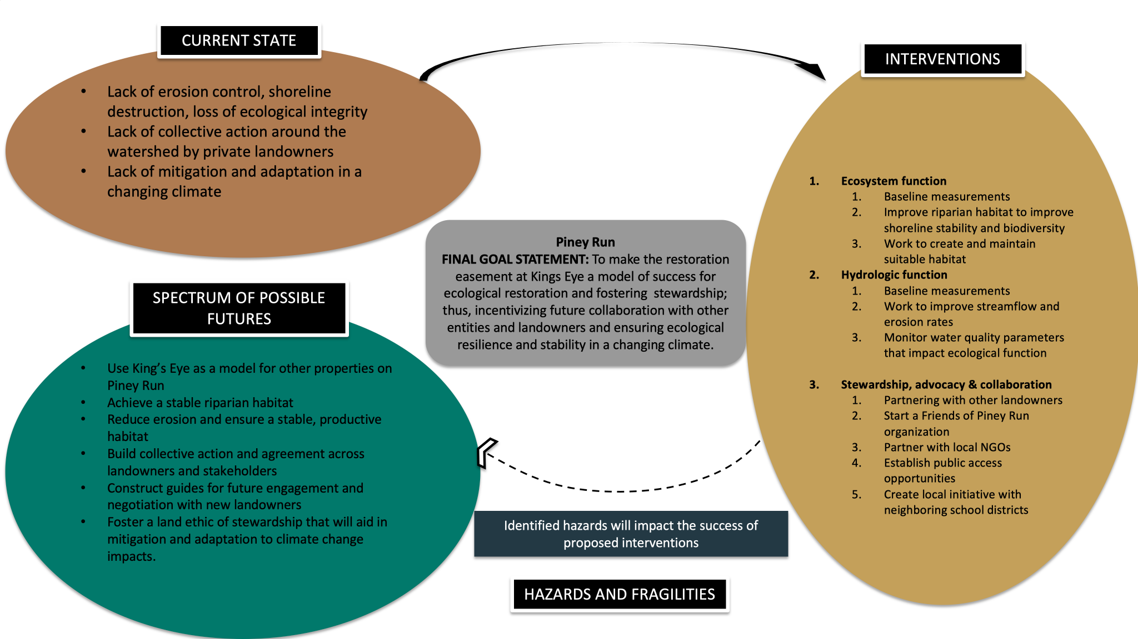

Slide 25
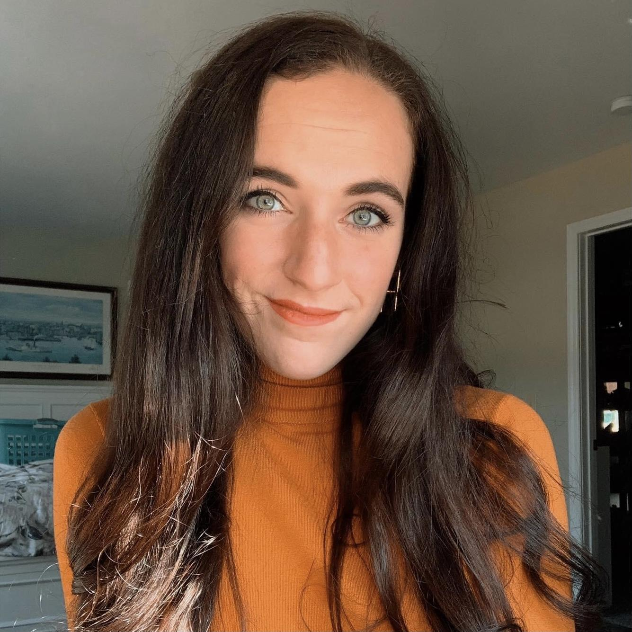
System Fragilities
Michala Hendrick
System fragilities are a constitutional condition of a system, that can lead to system degradation or breakdowns if exposed to a hostile environment or hazard.
A fragility is a systematic characteristic that can limit the system’s ability to do what it does or change what it does.
Identifying system fragilities for Piney Run
Freshwater ecology
Flora and fauna
Hydrology
Human adaptive capacity

Slide 26
System Fragilities
Freshwater ecology
Fragility
Potential impact
Erosion
Widening streambed, reduced natural hydrologic function
Water quality thresholds
Changes in pH, dissolved oxygen, turbidity and total algae
Temperature thresholds
Loss of suitable and habitable conditions
Increased productivity
Algal blooms, reduced water quality, health risks

Slide 27
System Fragilities
Flora and fauna
Fragility
Potential impact
Extirpation of native species, breakdown of the food chain
Sensitive habitat
Sensitive food web structure
Altered biological interactions between trophic levels

Slide 28
System Fragilities
Hydrology
Fragility
Potential impact
Threats of desiccation
Changes in input and output, loss of aquatic connectivity
Changes in the hydrologic cycle
Excess nutrient loading, increased risk of waterborne illnesses

Slide 29
System Fragilities
Human adaptive capacity
Fragility
Potential impact
Vulnerable drinking water source
Sourcing conflicts, loss of reliable drinking water
Loss of recreational resources
Loss of economic revenue and cultural opportunities
Decreased resilience and adaptive capacity to hostile environments or hazards
Loss of regulating services
Lack of adaptive capacity, a narrowing of possible futures, exacerbated anthropogenic impacts
Organizational capacity

Slide 30
Hazards and Threats
Michala Hendrick
A hazard is defined as a change of the system state that can lead to system degradation and/or reduction of the system’s capability to function.
Hazards trigger processes that eventually exploit fragilities and lead to associated consequences or impacts.
Modern climate change
Extraterrestrial hazards
Land cover changes
Exploitation
Geohazards
Natural hazards
Hydro- meteorological hazards
Anthropocene hazards
Fragmentation
Pollution
Biological hazards

Slide 31
Hazards for Piney Run
Michala Hendrick
Identifying hazards for Piney Run
Increased precipitation, terrestrial temperature changes and droughts
Increased extreme weather events
Increased stream temperature
Anthropogenic impacts

Slide 32
System Hazards
Increased precipitation, terrestrial temperature changes and droughts
Hazard
Potential impact
Increased month-month precipitation variability, greater frequency of short-term droughts.
Precipitation changes
Increased likelihood of droughts, extreme heat, intensified cold fronts
Temperature changes
Droughts
Decreased soil moisture and dependable water supplies

Slide 33
System Hazards
Increased extreme weather events
Hazard
Potential impact
Higher frequency of EWE
Decreased resiliency of Piney Run and human infrastructure
Greater intensity of EWE
Strong rain and snow storms, damaged crops, increased erosion

Slide 34
System Hazards
Increased stream temperature
Hazard
Potential impact
Increased temperature
Threatening of sensitive species
Decreased dissolved oxygen
Algal blooms, dead zones, loss of aquatic vegetation

Slide 35
System Hazards
Anthropogenic impacts
Hazard
Potential impact
Stakeholder buy-in, collaboration and partnership
Failure to achieve goal statement and long-term restoration
Increased development
Increased streamflow flashiness, alter stream channels and increased concentration of contaminants
Loss of native species and associated ecosystem services, fractured biodiversity and increased erosion
Land use changes

Slide 36
Climate scenarios by 2100 for Piney Run
Michala Hendrick
System Hazards
Low emissions²⁰⁰⁸
Frost days: 87
Precipitation: 10% increase
Summer days above 100 degrees: 5- 10
5°F
High emissions²⁰¹⁶
Frost days: 70
Precipitation: 12.6% increase
Summer days above 100 degrees: 10- 20
9°F
Unrestrained growth in emissions²⁰¹⁶
Frost days: ~50-55
Precipitation: ~ 13% increase
Summer days above 100 degrees: 20- 35
7-11°F
*Climate change projection data sourced from Maryland Commission on Climate Change (2008, 2016).

Slide 37
Human Development for Piney Run
Michala Hendrick
System Hazards
1
Growing population
571 million people by 2100
2
Growing demand of resources
Climate change is increasing water demand while shrinking supplies
3
Management implications
Meeting the growing needs of all stakeholders and ensuring conservation

Slide 38
Hazards and Fragilities
Michala Hendrick
Fragilities
Erosion
Water quality thresholds
Temperature thresholds
Increased productivity
Sensitive habitat
Sensitive food web structure
Sensitivity to desiccation
Changes in hydrologic cycle
Loss of drinking water
Loss of recreational resources
Loss of regulating services
Organizational capacity
Hazards (natural and anthropogenic)
Increased precipitation, terrestrial temperature changes and droughts
Increased extreme weather events
Increased stream temperature
Anthropogenic impacts

Slide 39
Spectrum Of Possible Futures
Jack Saladino
The spectrum of possible futures outlines a scenario based approach to the assessing the future of the system and subsystems of the Piney Run watershed.
Future Under Possible Human Development
Future Under Possible Climate Change Trends

Slide 40
Human Development Scenarios
Jack Saladino
1
Growing population
571 million people by 2100
2
Growing demand of resources
Climate change is increasing water demand while shrinking supplies
3
Management implications
Meeting the growing needs of all stakeholders and ensuring conservation

Slide 41
Future Under Human Development
Jack Saladino
1
Growing population
571 million people by 2100
2
Growing demand of resources
Climate change is increasing water demand while shrinking supplies
3
Management implications
Meeting the growing needs of all stakeholders and ensuring conservation
Human adaptive capacity
Freshwater ecology
Hydrology
Flora and fauna
Increased stakeholders hinders collaboration
Stream use becomes polarizing
Stream habitat degrades and disappears due to structural development
Stream habitat becomes more flashy
Pollution decreases water quality
Habitat degradation decreases overall biomass
Notes:
@Kimberly, interventions could be made to implement innovative techniques to ensure population growth-based development is done responsibly.

Slide 42
Futures Under Climate Change
Jack Saladino
Low emissions²⁰⁰⁸
Frost days: 87
Precipitation: 10% increase
Summer days above 100 degrees: 5- 10
5°F
High emissions²⁰¹⁶
Frost days: 70
Precipitation: 12.6% increase
Summer days above 100 degrees: 10- 20
9°F
Unrestrained growth in emissions²⁰¹⁶
Frost days: ~50-55
Precipitation: ~ 13% increase
Summer days above 100 degrees: 20- 35
7-11°F

Slide 43
Futures Under Climate Change: Low emissions
Jack Saladino
Anthropogenic impacts
Increased precipitation, terrestrial temperature changes and droughts
Increased stream temperature
Increased extreme weather events
Human adaptive capacity
Freshwater ecology
Hydrology
Flora and fauna
Stream is viable for human interaction
Downstream systems are a viable source for drinking water
Minimal erosion, stream shape is stable
Stable bank and full habitat
Moderate turbidity levels
Slight decrease in dissolved oxygen
Brown trout population is stabilized but not growing
Native species are allowed to reclamate habitat
Notes:
@Kimberly, interventions in this scenario have the highest potential for success. We define success as increased resilience, collaboration, and education.

Slide 44
Futures Under Climate Change: High emissions
Jack Saladino
Anthropogenic impacts
Increased precipitation, terrestrial temperature changes and droughts
Increased stream temperature
Increased extreme weather events
Human adaptive capacity
Freshwater ecology
Hydrology
Flora and fauna
Adaptive capacity limited by stream’s resilience to climate change
Large erosion events leads to gradual habitat degradation
Large eutrophication events leads to limited hypoxic zones
Large erosion events leads to poor turbidity
High stream temps leads to low dissolved oxygen content
Brown trout species diminishes but maintains small adaptive population
Invasive species increase
Notes:
@Kimberly, adaptive capacity is limited in this scenario and therefore mitigation efforts may be futile. Further research is necessary to make recommendations.

Slide 45
Futures Under Climate Change: Unrestrained growth in emissions
Jack Saladino
Anthropogenic impacts
Increased precipitation, terrestrial temperature changes and droughts
Increased stream temperature
Increased extreme weather events
Human adaptive capacity
Freshwater ecology
Hydrology
Flora and fauna
River becomes abandoned
Conservation easement is wasted
Total riparian and terrestrial degradation
Loss of habitat
Functional extinction
Desiccation from rapid precipitation and evaporation
Pathogenation and water toxicity
Brown trout population collapses
Native species decline
Invasive species flourish
Notes:
@Kimberly, mitigation efforts in this scenario are unlikely to have an effect and resources should be allocated to plan for system collapse

Slide 46
Characteristics of Successful Interventions
Jack Saladino
Increased Resilience and Stability
Education
Collaboration
Notes:
@Kimberly, rather than combating climate change and human development directly, we would like to implement interventions that aim to increase resilience and stability in the watershed, emphasize education about the watershed, and promote collaboration with current and future stakeholders on all levels.

Slide 47
Interventions
Kimberly Allen
Increased Resilience and Stability
Vegetation mapping
Invasive Species Mapping
Pros: Tool for understanding the extent and pattern of vegetation growth, helps model how vegetation might change under various climate change scenarios. Great opportunity for higher education involvement.
Con: Needs funding, time consuming, would need to be updated and monitored.
Pros: Comprehensive map of invasive species locations.
Allows higher education to study invasive species transport and migration.
Cons: Needs funding, time consuming, would require monitoring, and possible low interest.

Slide 48
Interventions
Kimberly Allen
Increased Resilience and Stability
Limit Human Land Disturbance
Control Deer Herd Numbers
Pros: Encourage flora and fauna regrowth and stabilization. Limit soil erosion. Eliminate pollution.
Cons: Limits recreation opportunities. Limits education capabilities.
Pros: Relieves stress on flora while it grows.
Cons: Must be regulated. Landowners may not consent to public hunting. Human land disturbance.

Slide 49
Interventions
Kimberly Allen
Increased Resilience and Stability
Restrict Fishing During Droughts
Planting Trees and Water Gardens
Pros: Increase rate of recovery after droughts.
Cons: Must be regulated and requires enforcement.
Pros: Shades the ground and keeps it cooler, filter stormwater runoff, decrease pollution from sediment and fertilizers, attract native species.
Cons: Requires construction.

Slide 50
Interventions
Kimberly Allen
Education
Friends of Piney Run
Higher Education Monitoring and Analytics
Pros: Grow collaborative capacity while indoctrinating the local youth with stewardship principles.
Cons: Liability issues with having kids come to Piney Run. Possible low interest from schools. Human land disturbance.
Pros: Low cost human resource to monitor stream analytics and changes.
Cons: Low interest. Inconsistent. Human land disturbance.
Notes:
Advantage education. Disadvantage/ human land disturbance/ may upset local community

Slide 51
Interventions
Kimberly Allen
Collaboration
Mediation Expert
Citizen Science/Brown Trout Tagging
Building Relations With HWWTP
Pros: Facilitate communication between parties.
Cons: Expensive. Not guaranteed.
Pro: Document species inventory. Instills collaboration between recreation and information. Provides incentive for catch and release style fishing
Cons: Needs to attract community engagement. Funding would be needed for tagging and tracking.
Pros: The Hampstead treatment plant may be interested to improve practices.
Cons: Plant may not be interested in improving practices. Piney Run would need a representative.

Slide 52
Discussion and Conclusion
Tiffany Wood
Piney Run is an important natural and socioeconomic resource which needs to be protected by landowners and the surrounding governments, that is currently apart of a stream restoration project
Our goal is to provide recommendations to those involved to ensure the long term health of the water way
Hydrology
Human/
Community
Piney Run
Flora/Fauna
Freshwater Ecology

Slide 53
Discussion and Conclusion
Tiffany Wood
The use of models has helped us understand how the systems are all interconnected

Slide 54
Discussion and Conclusion
Tiffany Wood
High resources/ authority
Carroll county dep. Of land and resource mgmt.
Carroll county gvmt. Officials
Private landowners
Water treatment plant managers
MD Freshwater fish division
Baltimore county Natural Resource department
Balt. County department of planning
Baltimore county soil conservation district
Low interest
High interest
NGOs
Local ag. Owners
Potential fish stocking stakeholders
Local businesses (brewery, horse farm?)
Low resources/ authority

Slide 55
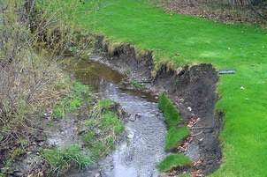
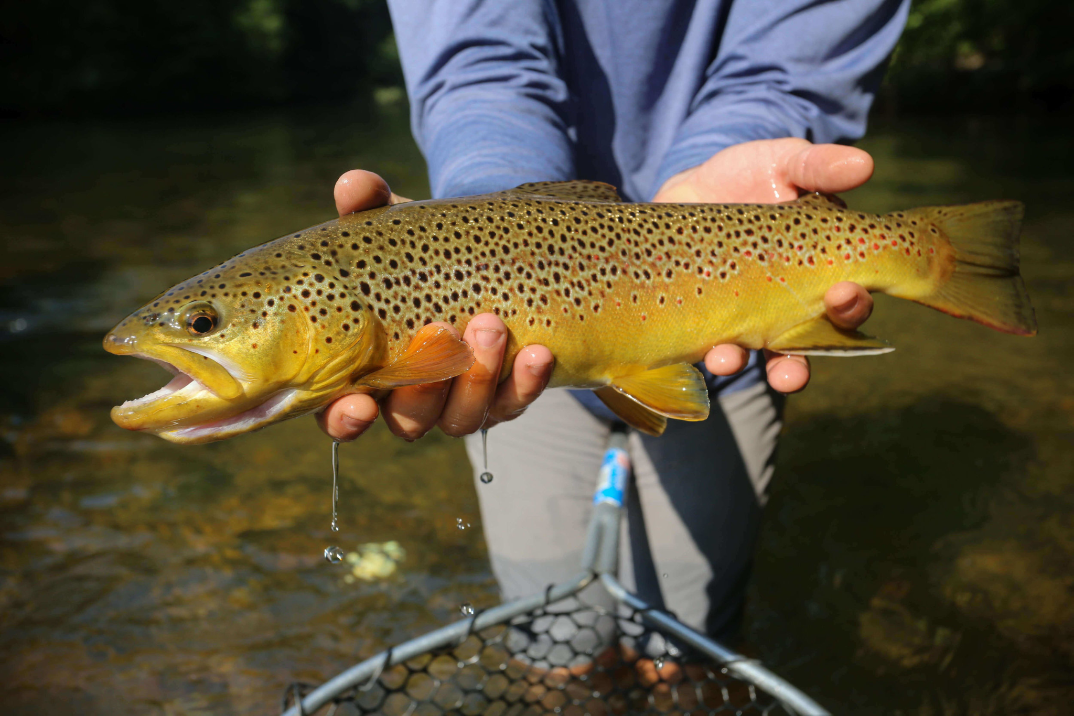
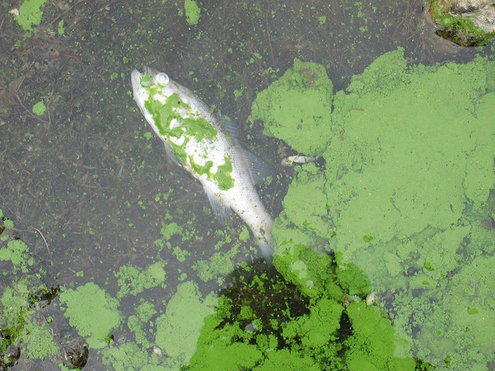
Discussion and Conclusion
Tiffany Wood
Vulnerabilities and Hazards
It is also important to make stakeholders aware of the hazards and threats that exploit the system fragilities

Slide 56
Discussion and Conclusion
Tiffany Wood
Spectrum of Futures
Future Under Possible Human Development
Future Under Possible Climate Change Trends
Growing Population
Low Emissions
Growing demand of resources
High Emissions
Management implications
Unrestrained Growth in Emissions

Slide 57
Discussion and Conclusion
Tiffany Wood
Interventions

Slide 58
Recommendations
Keigan Thornton
Proposed actions for the long term sustainability of Piney Run take into consideration the ongoing project for the stream, interactions in and around the environment as well as actions from the community.
Recommendations =/= Stakeholder Specific
The following recommendations are presented from a transdisciplinary approach, meaning that they involve multiple groups, organizations, and schools of thought in order to successfully executed.

Slide 59
Establishing stewardship efforts
Citizen science incentives
Educational outreach
Collaboration efforts
Utilize easements with Land Preservation Trust to reward in depth interactions and relationships with the environment, creating more opportunities for landowners.
Use the Piney Run area to conduct educational opportunities from school age to higher levels of education, using the project as a model for local restoration practices.
Place programs involving data collection from Piney Run and reward the regular submission of data from locals.
Use of NGO and Gov. collaboration in using Piney Run as a model for future projects involving local restoration projects.

Slide 60
Recommendations
Perform a full hydrologic inventory and baseline measurements for the current function, condition and quality.
Communicate restorative practices with other landowners nearby.
Stream Restoration Project Managers and Main Landowner
Communicate with educational institutions to establish outreach programs.
Establish access to Piney Run for public access for the use of citizen science efforts.
Main Landowner and the Community of Piney Run
Start a Friends of Piney Run organization that can grow collaborative capacity within the watershed.
Organize efforts with surrounding NGOs to assist with brown trout and other biodiversity monitoring efforts
The Community of Piney Run and Non-government Organizations

Slide 61
Recommendations
Keigan Thornton
Establish monitoring stations and begin long term data collection.
Set-up initiatives for citizen science efforts.
Utilize Land Preservation Trust in order to protect more of Piney Run.
Develop further mitigation strategies for Hampstead Wastewater Treatment
The Community of Piney Run and Government Organizations
Create a Baltimore Co./Carroll Co. public school initiative to maintain local lands/waterways
Establish a liaison between the environment of Piney Run to interact with local and outside sources.
The Community and the Environment of Piney Run

Slide 62
Adaptive Planning for Piney Run, MD
Stability and resiliency in a changing climate
This concludes our presentation. We will now take questions from attendees.
Notes:
· That concludes our presentation for this afternoon.
· We want to thank you for your time and attention and the opportunity to share these findings with you.
· We will now take any questions from the audience

